Slide 1
Face Recognition Attendance System
Presented By:
Satyam(191500730)

Slide 2
OUTLINE
About the Project
Objective
Requirements
Snapshots of the projects
Scope of this project
Conclusion

Slide 3
ABOUT THE PROJECT
This project “Face Recognition Attendance System” has been developed on Python and use MySql to store the data in backend.
This project is very useful to save time of the people who work in industry and useful to save the time teacher and also student by using automatic attendance system.

Slide 4
Sections in this Application :
1 Login Page: to enter in app space just use email and password
2. Student Details: in this page store the student details
3. Train Data: This section train the data which are saved in data folder by using student details section.
4. Attendance: This section has the attendance data which are saved by student details section data stored in database
5. Face Detetcor: This section detect the face image.
6. Photos: This section have photos sample

Slide 5
OBJECTIVE
Instead of using the conventional methods, this proposed system aims to develop an automated system that records the student's attendance by using facial recognition technology. The main objective of this work is to make the attendance marking and management system efficient, time saving, simple and easy.

Slide 6
REQUIREMENTS
Software Specification Used:-
Languages/Technologies Used: Python, MySql
IDE Used: Visual Studio Code
User Interface Design: Graphical user interface
Operating System : window 7 or above , linux, mac os x

Slide 7
Hardware Used:
1.Processor : intel Pentium processor or other 1GHz or more 2. Operating System : window 7 or above , linux, mac os x 3. RAM : minimum 4GB RAM or above 4. Hardware Devices: minimum 32MB graphic card RAM or above 5. • Hard disk : space of 500GB or above

Slide 8
THIS IS HOW THIS APPLICATION LOOK LIKE
Hope you will like it :)

Slide 9
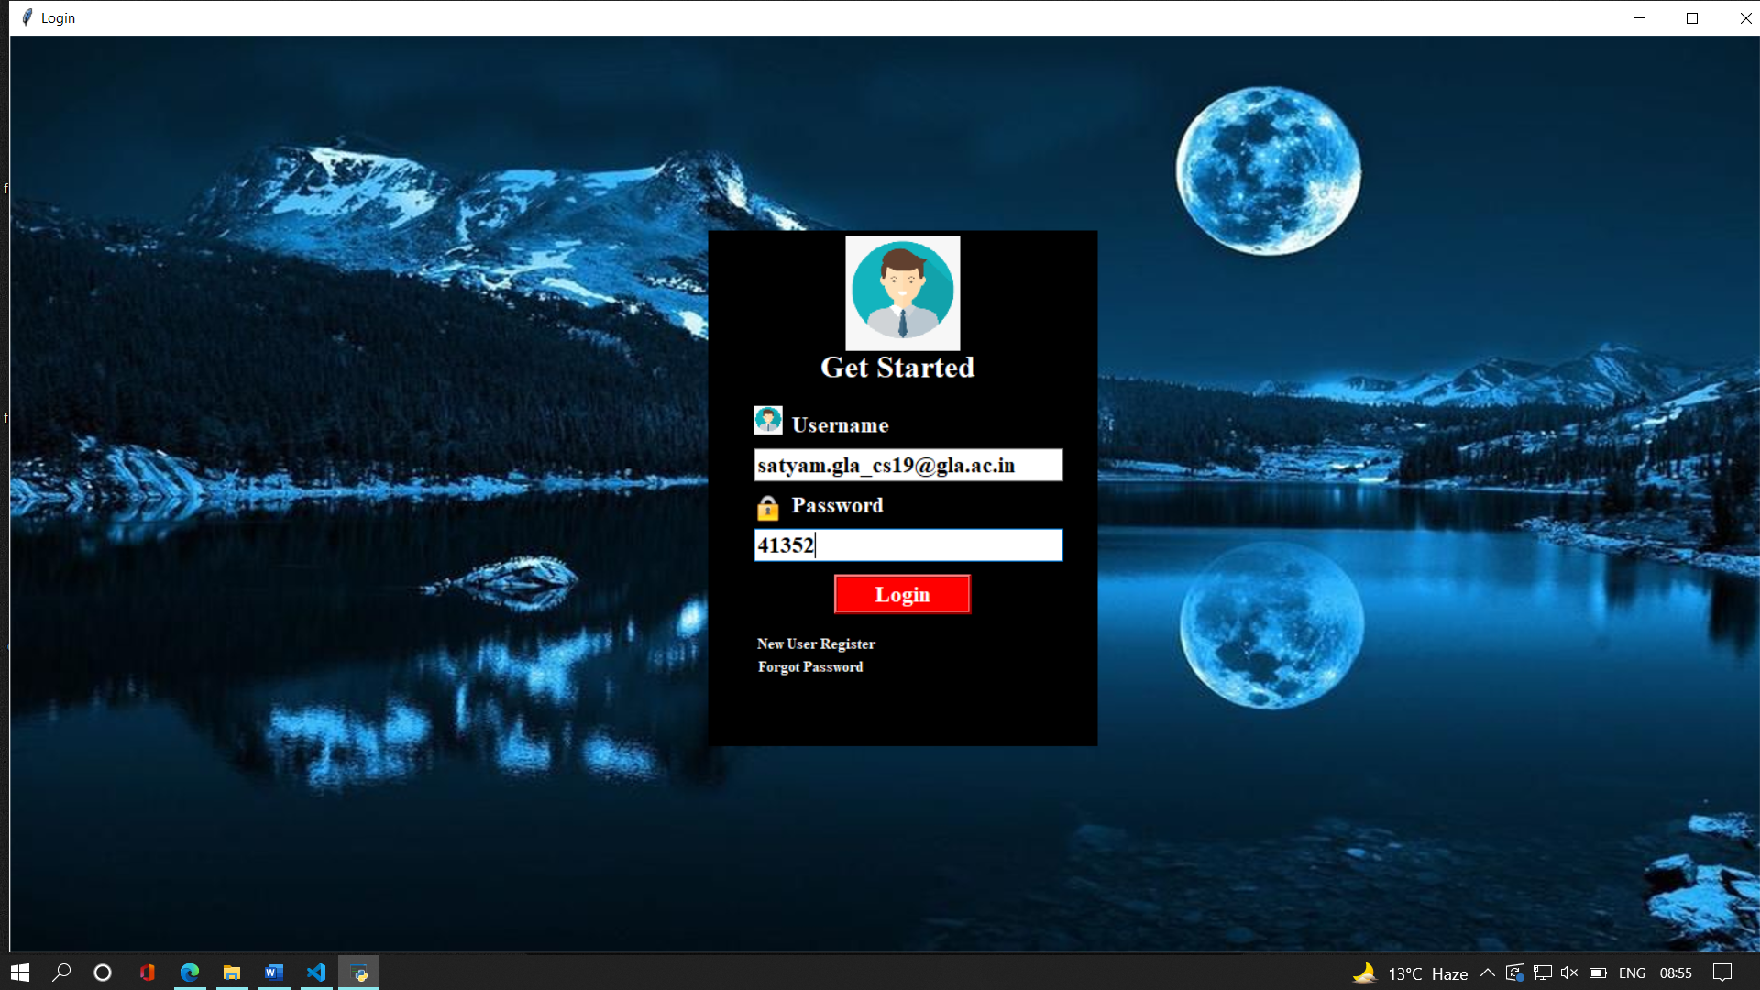
Login Section

Slide 10
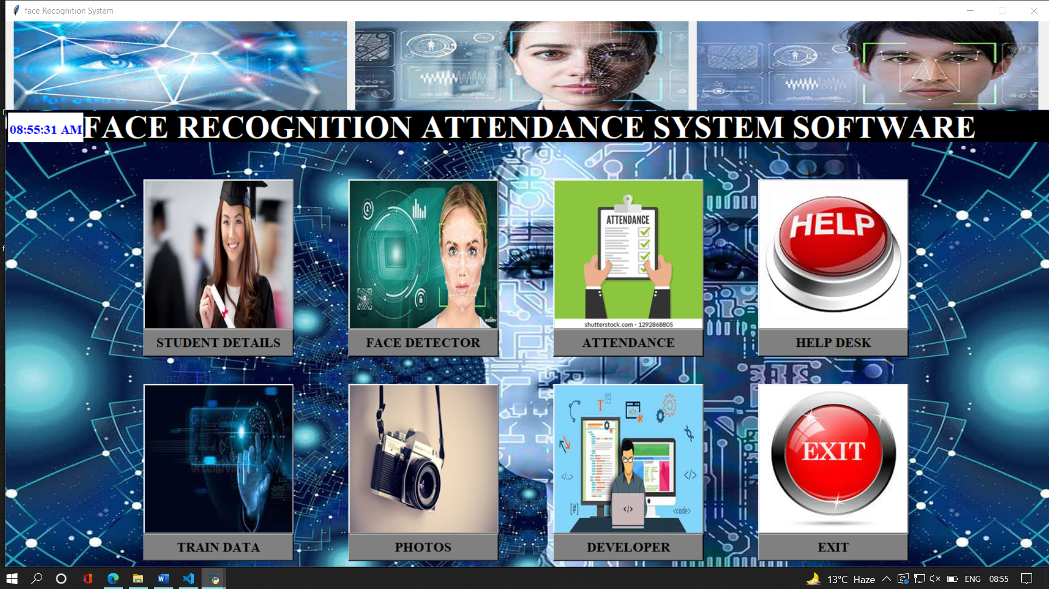
2. Main Section

Slide 11
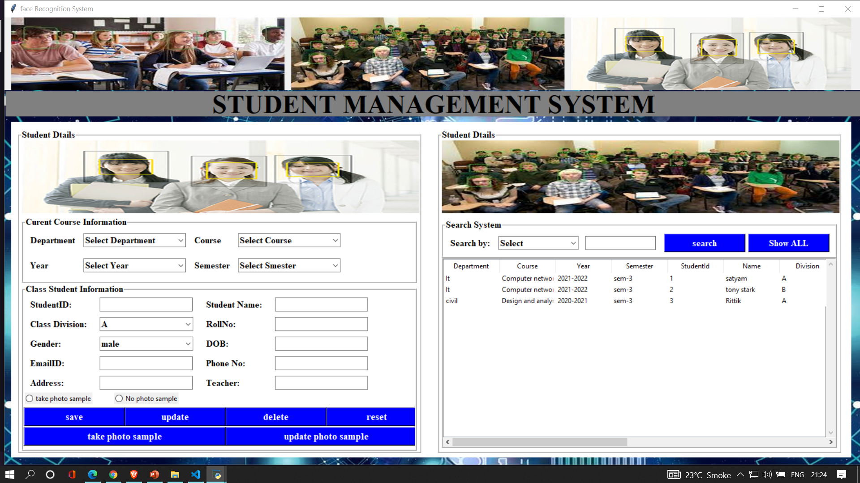
3. Student Details

Slide 12
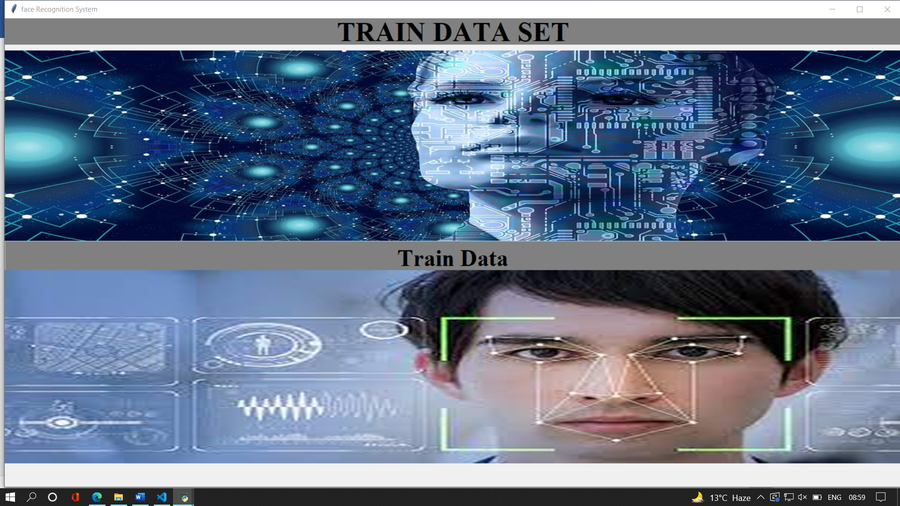
4. Train Data Section

Slide 13
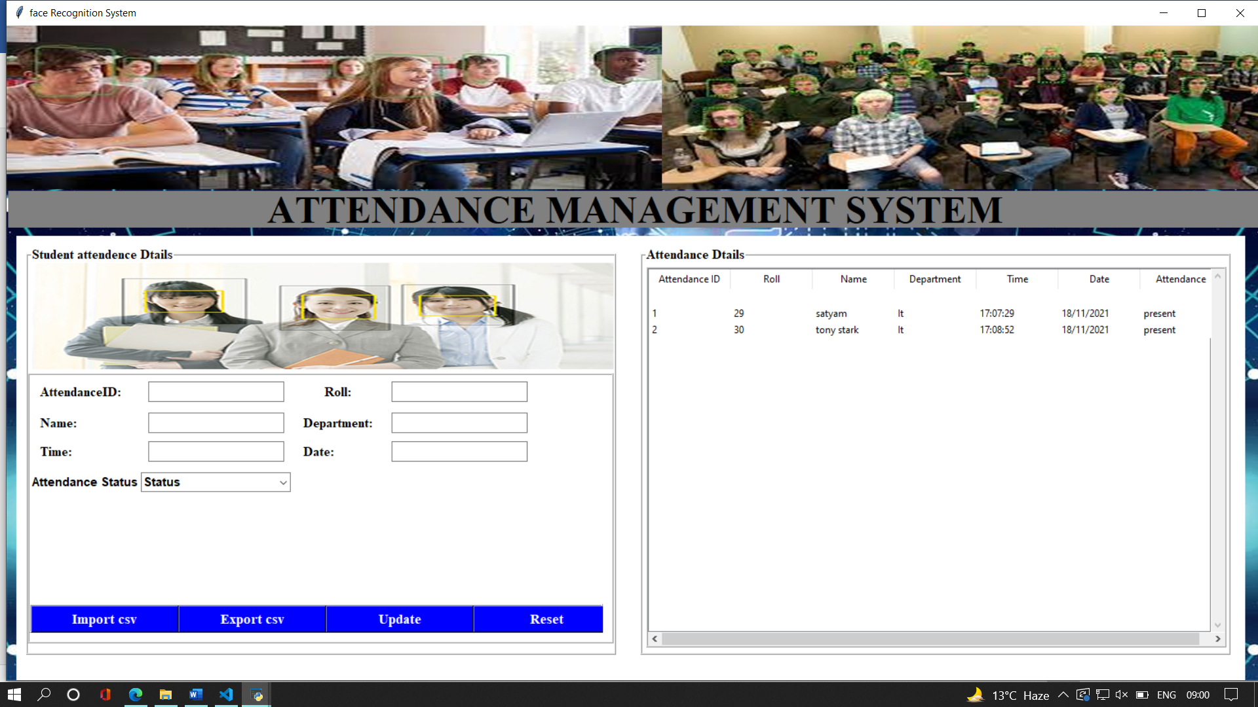
5.Attendance Section

Slide 14
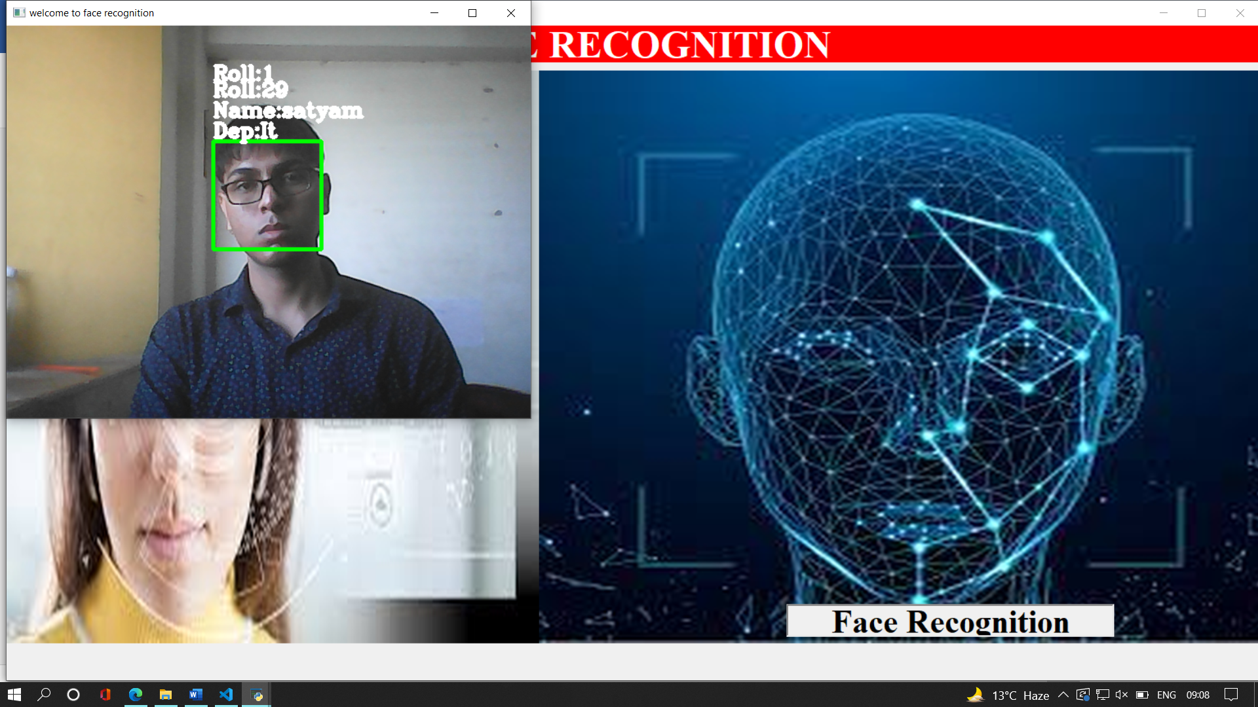
6.Face Detection Page

Slide 15
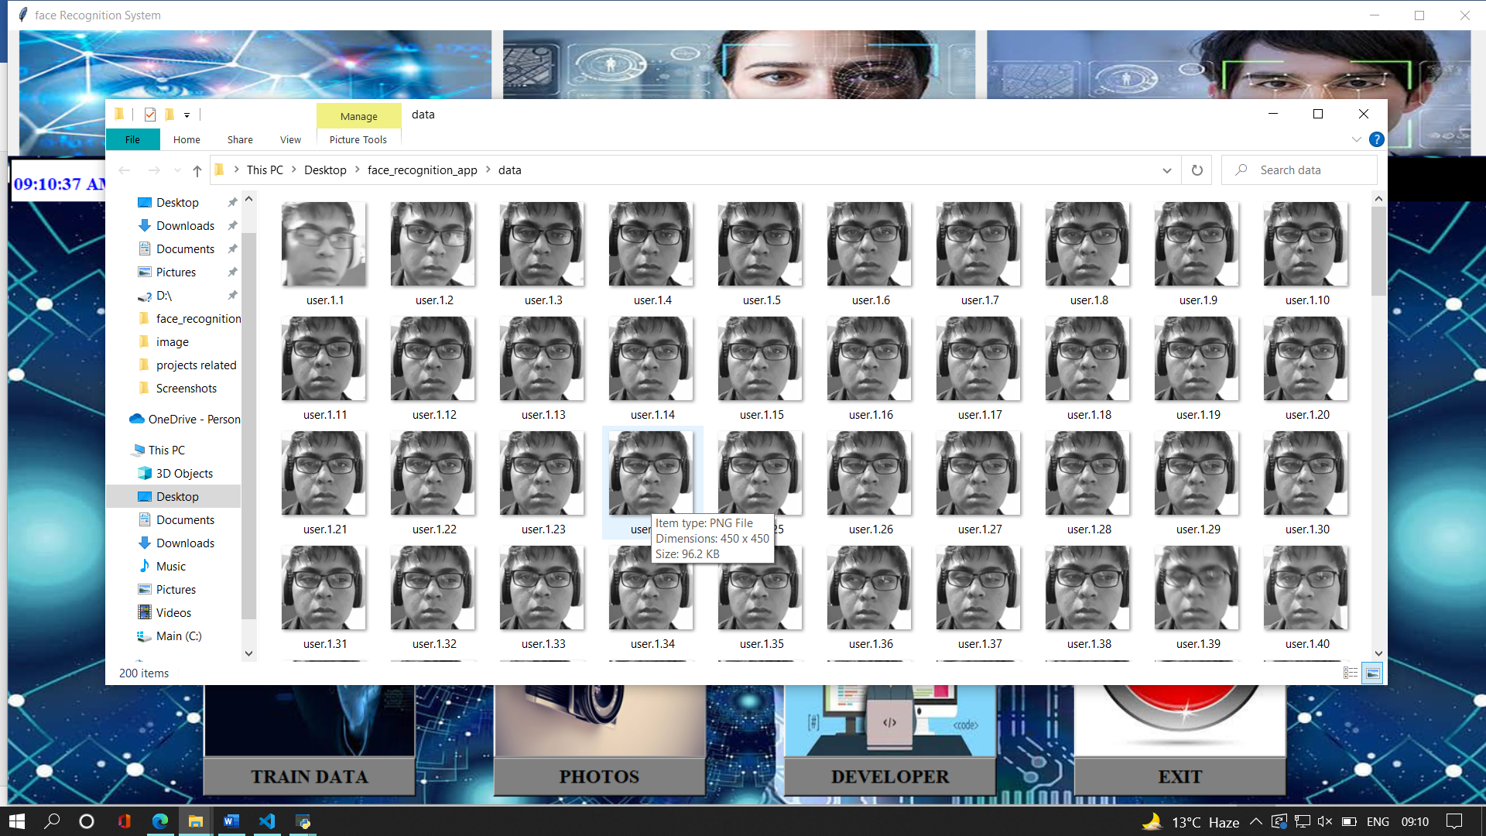
7.Photos Section

Slide 16
Scope for future work
Further, 2 or more IP cameras can be employed and each image can be processed separately. The results of these can be merged to obtain better results and accuracy in denser classrooms
And in this project time for the specific time appearance of object can also be increased.

Slide 17
Conclusion
a reliable, secure, fast and an efficient system has been developed replacing a manual and unreliable system. This system can be implemented for better results regarding the management of attendance and leaves. The system will save time, reduce the amount of work the administration has to do and will replace the stationery material with electronic apparatus and reduces the amount of human resource required for the purpose.

Slide 18
Thank you

